Slide 1
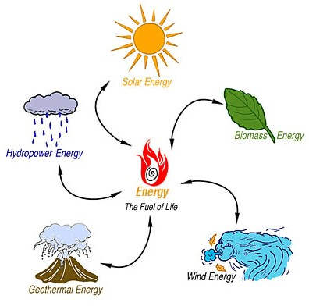
More Types of Energy

Slide 2

What is Energy?
Recall:
Energy (E) is defined as:
The ability to do work
It is a scalar quantity
measured in joules [J]
Notes:
Where 1 joule is the amount of work done by 1 force being applied through 1 m in the same direction of the force

Slide 3
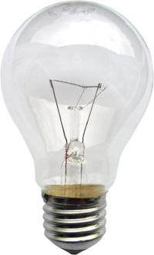
Variations on Energy Units
1 Joule is not much energy. Other common units include:
1 kJ = 10³ J
1 MJ = 10⁶ J
1 GJ = 10⁹ J
1 kW⋅h = 3.6 MJ = 3.6x10⁶ J
Notes:
For example, a 60 W light bulb will use 60 joules of energy every second – that’s 3600 J of energy each minute, which is 86 400 J of energy each hour, 2073600 J of energy every day etc etc

Slide 4

Example
An average Canadian family consumes 16 000 kW⋅h of electrical energy in one year. What is the equivalent in:
a) J?
b) W⋅h?
Notes:
Actually, they consume over this amount. But we needed a specific value to do our calculations!

Slide 5

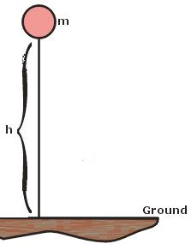
Mechanical Energy
Recall:
The mechanical energy of an object is a combination of:
Kinetic Energy: the energy of motion
Gravitational Potential Energy: Energy possessed by an object due to its position relative to the surface of the Earth
Notes:
An objects kinetic energy is: i) proportional to mass ii) proportional to the square of the distance
The term ‘potential energy’ means that an object will experience a force which will cause a displacement (work) if it is released
An objects gravitational potential energy is: i) proportional to its mass, ii) proportional to its height iii) proportional to the gravitational field strength

Slide 6

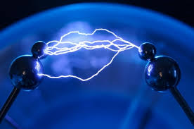
Different Types of Energy
Radiant Energy:
Potential and kinetic energy due to light
Electrical Energy:
1. Static electricity: Potential energy possessed by static charges
2. Current electricity: Potential and kinetic energy possessed by flowing charges
Notes:
Radiant Energy (aka light energy): energy possessed by oscillating electric and magnetic fields (kinetic and potential)
Electrical Energy: energy possessed by accumulated static charges (potential)

Slide 7

Different Types of Energy
Elastic Energy:
Potential energy possessed by materials that are stretched, compressed, or twisted
Notes:
Elastic energy: energy possessed by materials that are stretched, compressed, or twisted and tend to return to their original shape (potential)

Slide 8
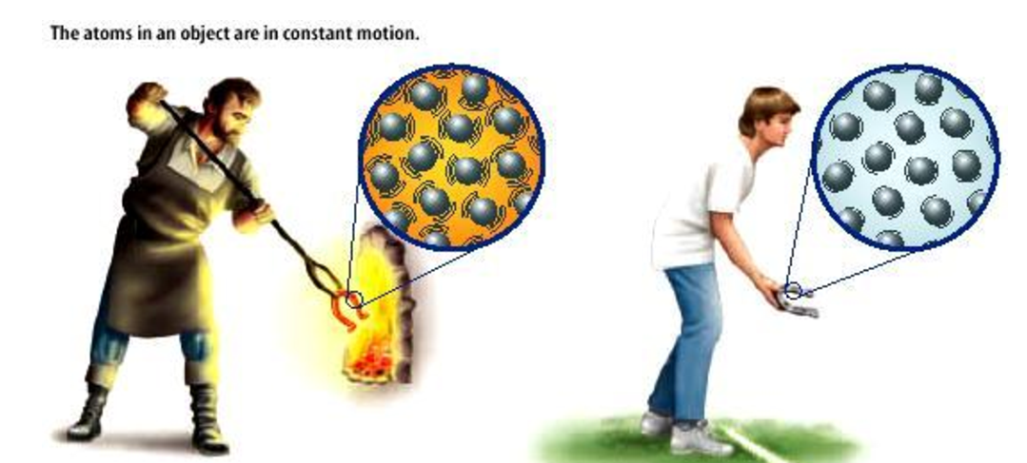
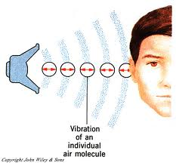
Different Types of Energy
Thermal Energy:
Potential and kinetic energy possessed by moving atoms and molecules
Sound Energy:
Potential and kinetic energy possessed by air molecules
Notes:
Thermal Energy: energy possessed by randomly moving atoms and molecules (potential and kinetic)
Sound Energy: energy possessed by large groups of oscillating atoms and molecules (potential and kinetic)

Slide 9
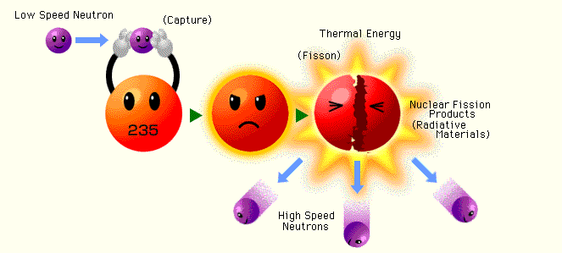
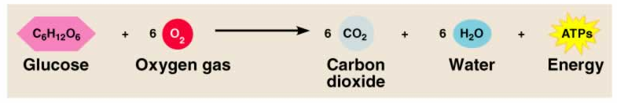
Different Types of Energy
Nuclear Energy:
Potential energy possessed by protons and neutrons in nuclei
Fission OR Fusion OR Radiation
Chemical Energy:
Potential energy associated with molecular bonds
Notes:
Nuclear energy (aka atomic energy): energy possessed by protons and neutrons in atomic nuclei (potential)
(http://atropos.as.arizona.edu/aiz/teaching/a250/pp.html). It may be released through fission, fusion, or radiation. We will study these in more detail in chapter 7.
Chemical energy: energy associated with bonds in molecules (potential)

Slide 10

Different Types of Energy
Rest Mass Energy:
The total energy that an object has due to its mass.
E = mc²
Where E is energy [J]
m is mass [kg]
c is speed of light 3.0x10⁸ m/s

Slide 11

Example
How much energy would be released if a 42 kg physics student could be completely converted into energy?

Slide 12
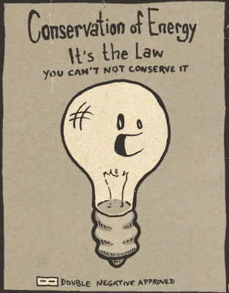
Conservation of Energy
While energy can be transferred between objects, and can change forms, it CANNOT be created or destroyed

Slide 13
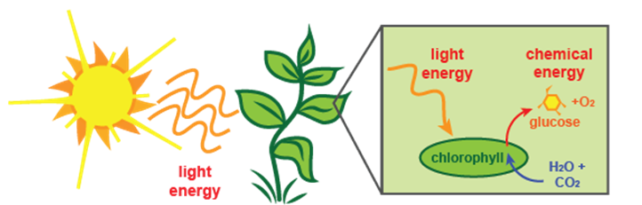
Example
Calculate the type(s) of energy at each point in the diagram below.

Slide 14
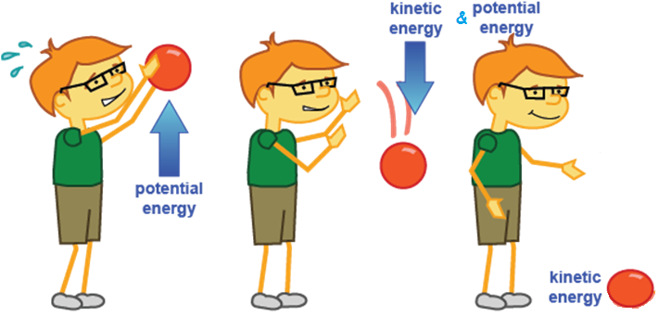
Example
Calculate the type(s) of energy at each point in the diagram below.

Slide 15
Example
A ball of mass 0.82 kg is raised to a height of 1.6 m. Calculate the total energy as well as the gravitational potential and kinetic energy at each point. Then find the speed of the ball.
0.75 m

